Slide 1
Planet
Interactive
Medium-Fi Prototype
Kristine Ma, Lucas Wang, Evelyn Song, Carolyn Lee

Slide 2
Table of Contents
01
02
03
Team
value prop
Problem/ solution overview
04
05
06
Values in design
TAsk Flow
Live demo

Slide 3
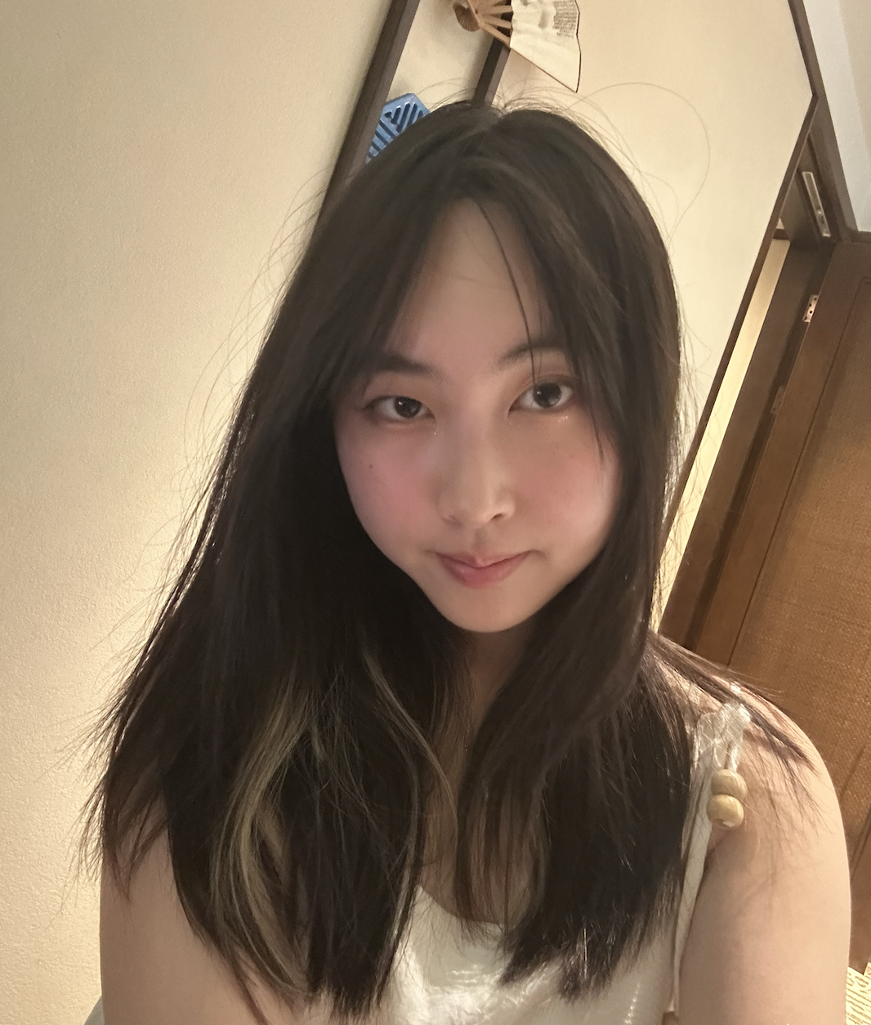
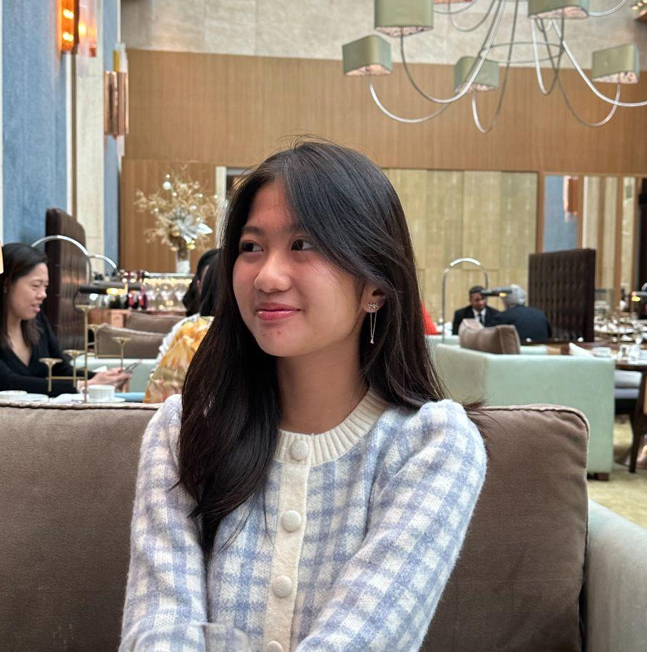
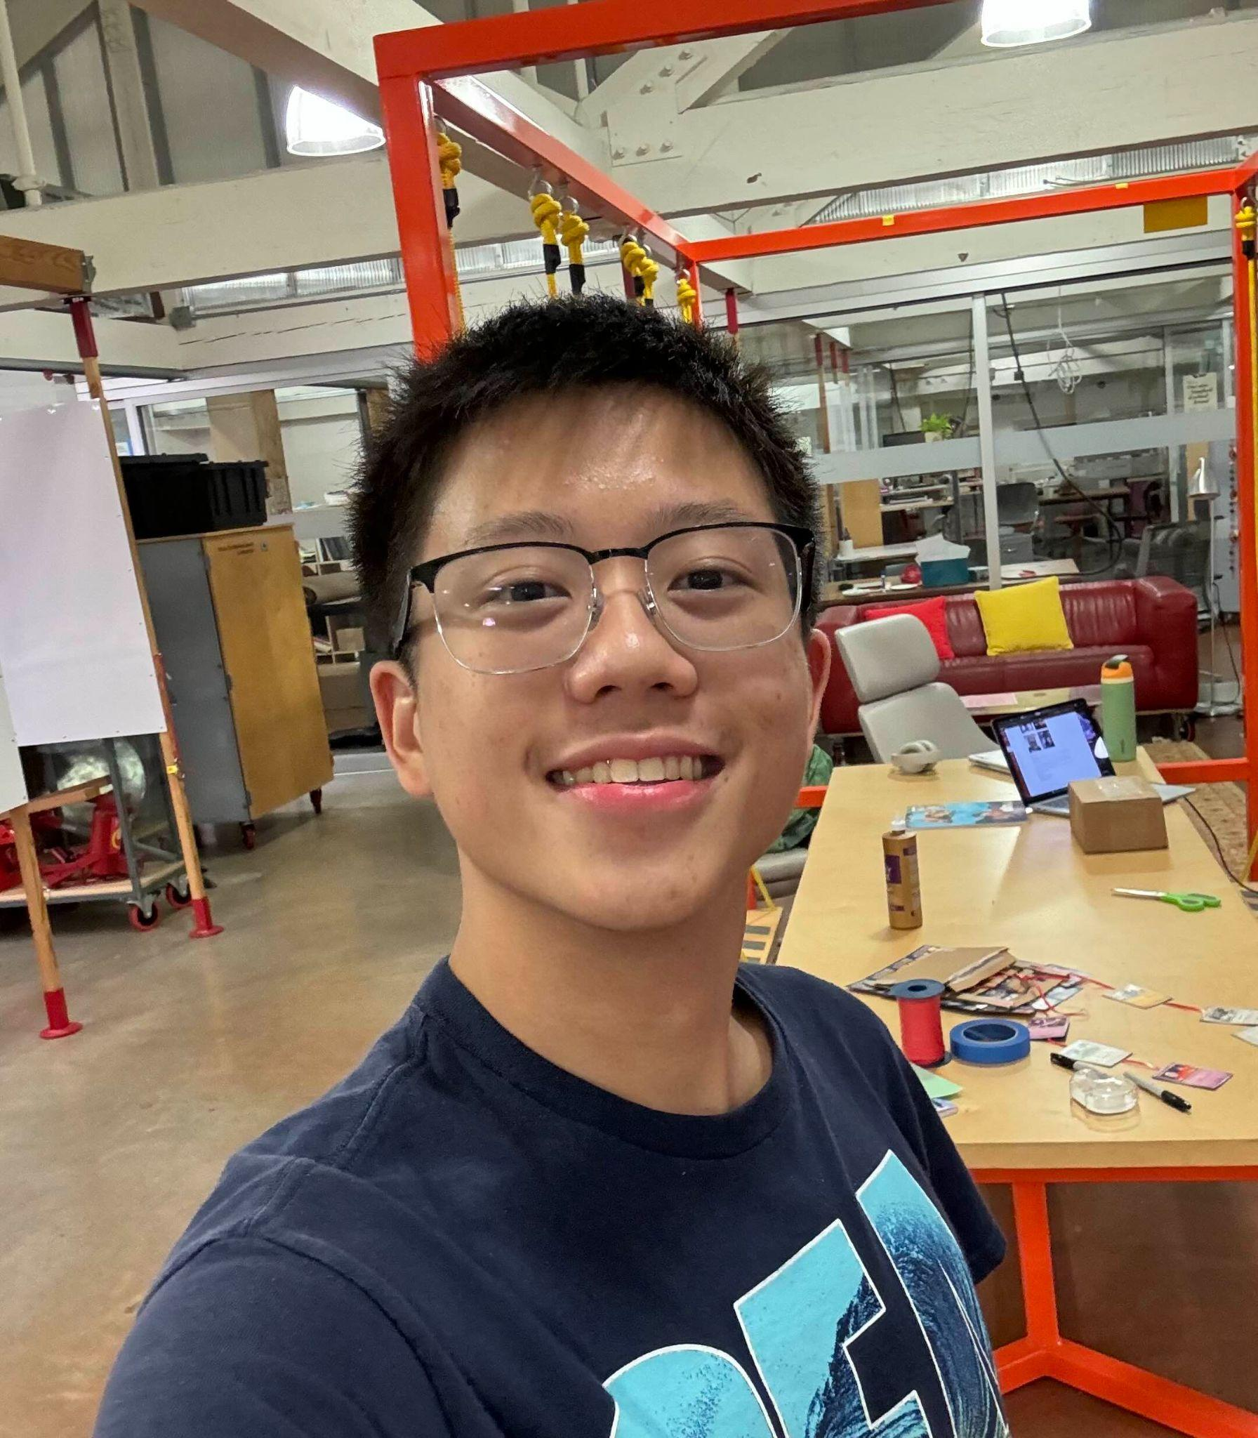

We are team planet!
Kristine Ma
Carolyn Lee
Lucas Wang
Evelyn Song
Junior
Symbolic Systems (HCI)
Junior
Computer Science (HCI)
Sophomore
Design +
CS (HCI)
Junior
Human Biology + CS (HCI)

Slide 4

Friends living in different worlds?
Just plan(et).

Slide 5
Value proposition
Planet lets you visually connect with your friends' emotions and statuses in real-time, so you never feel alienated and always know who's able to hang out or needs companionship.

Slide 6
Problem Overview
Primary user
Problem We’re Tackling
College students with existing friend groups but who find it difficult to reach out and connect
Reaching out to friends is seen as time consuming and an inconvenience to the other person

Slide 7


Slide 8
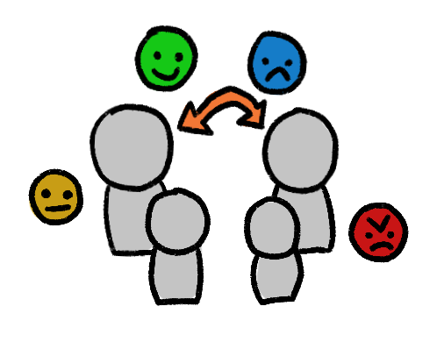
Proposed solutions
Notes:
Update friends on the current moods of other friends, reducing the awkwardness of talking about emotions directly

Slide 9
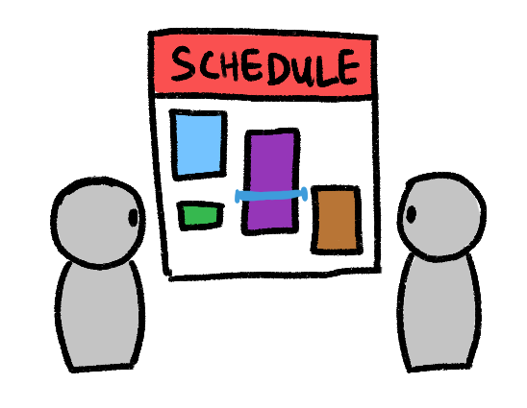
Proposed solutions
Notes:
Allow friends to easily see busy times on each others’ schedules without back-and-forth hassle

Slide 10
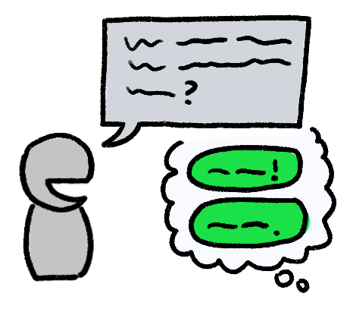
Proposed solutions
Notes:
Help friends engage with each other quickly and easily via ”quick replies” to posted emotions / statuses

Slide 11

Proposed solutions

Slide 12
ValueS in design

Slide 13
Values encoded in product
Prioritize connection, emotional awareness, and inclusivity.
“Fostering genuine relationships by making emotional states and social availability visible, emphasizing user’s well-being and creating a community that helps combat feelings of alienation”
Notes:
Prioritize connection, emotional awareness, and inclusivity. The app seeks to foster genuine relationships by making emotional states and social availability visible, emphasizing users’ well-being and creating a community that helps combat feelings of alienation. Transparency, respect for privacy, and user empowerment are additional values, ensuring that users feel comfortable and in control of the information they share.
Real-time Emotional Status Updates: By allowing users to update and share their emotions and availability for social interaction, Planet emphasizes emotional awareness and encourages genuine connections. Users can instantly see which friends are open to hanging out or may need support, reinforcing a sense of inclusivity and understanding.
Visual Representation of Friends’ ‘Planet Bubbles’: The app uses a metaphor of planets to visually convey the emotional and social distance between friends. This decision makes the experience more engaging and helps address the feeling of alienation by visually depicting connections in an accessible, intuitive way.
Privacy Settings and Customization: Planet includes features that let users control who can see their status updates and emotional states, respecting user privacy and empowering them to choose how they engage.
Simple and Low-effort Check-ins: The design minimizes the effort needed to reach out to friends, making interactions feel less burdensome. This reflects the value of accessibility, ensuring that even users in a bad headspace can feel connected without feeling overwhelmed.
Privacy VS Connection: The visibility tag leaves the user a lot of space to choose who they’re sharing info with. Though this ensures privacy, it might also reinforce existing friend groups and contribute to the alienation of people who already feel disconnected. This could create an unintended exclusivity, making it harder for some users to feel included and supported within the app’s social environment.
Simplicity vs. Depth of Interaction: While the app is designed for easy and effortless connection, this could reduce the depth of meaningful interactions. Users might rely on visual updates instead of engaging in deeper, one-on-one conversations, potentially creating superficial connections. Balancing simplicity with meaningful engagement is a key tension to manage.

Slide 14
Value in design
Relevant design features:
Real-time Emotional Status Updates
Visual Representation of Friends’ ‘Planet Bubbles’
Privacy Settings and Customization
Simple and Low-effort Check-ins
Value Tensions:
Privacy vs. Connection: Reinforce friend groups <-> unintended exclusivity?
Simplicity vs. Depth of Interaction: ease of use -> superficial connections?
Notes:
Prioritize connection, emotional awareness, and inclusivity. The app seeks to foster genuine relationships by making emotional states and social availability visible, emphasizing users’ well-being and creating a community that helps combat feelings of alienation. Transparency, respect for privacy, and user empowerment are additional values, ensuring that users feel comfortable and in control of the information they share.
Real-time Emotional Status Updates: intuitive. We emphasizes emotional awareness. Users can instantly see which friends are open to hanging out or may need support, reinforcing a sense of inclusivity and understanding.
Visual Representation of Friends’ ‘Planet Bubbles’: The app uses a metaphor of planets to visually convey the emotional and social distance between friends.
Privacy Settings and Customization: users can control who can see their status updates respecting their privacy.
Simple and Low-effort Check-ins: The design minimizes the effort needed to reach out to friends, making interactions feel less burdensome. This reflects the value of accessibility, ensuring that even users in a bad headspace can feel connected without feeling overwhelmed.
Privacy VS Connection: The visibility tag leaves the user a lot of space to choose who they’re sharing info with. Though this ensures privacy, it might also reinforce existing friend groups and contribute to the alienation of people who already feel disconnected. This could create an unintended exclusivity, making it harder for some users to feel included and supported within the app’s social environment.
Simplicity vs. Depth of Interaction: While the app is designed for easy and effortless connection, this could reduce the depth of meaningful interactions. Users might rely on visual updates instead of engaging in deeper, one-on-one conversations, potentially creating superficial connections. Balancing simplicity with meaningful engagement is a key tension to manage.

Slide 15
Usability goals
&
key measurements

Slide 16
Usability goals & measurements
Intuitiveness
effectiveness
Rationale
The interface should feel obvious to navigate
Key measurement
Qualitative comments from unfamiliar users
(target: “good heuristics”)
Rationale
Interface allows for near-instant reactions
Key measurement
Time taken to complete tasks
(target: <= 90 sec)

Slide 17
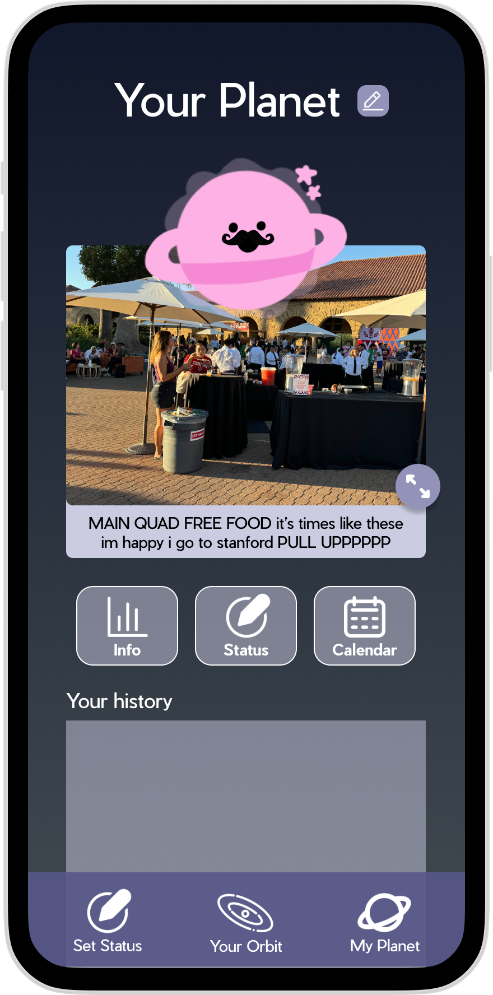
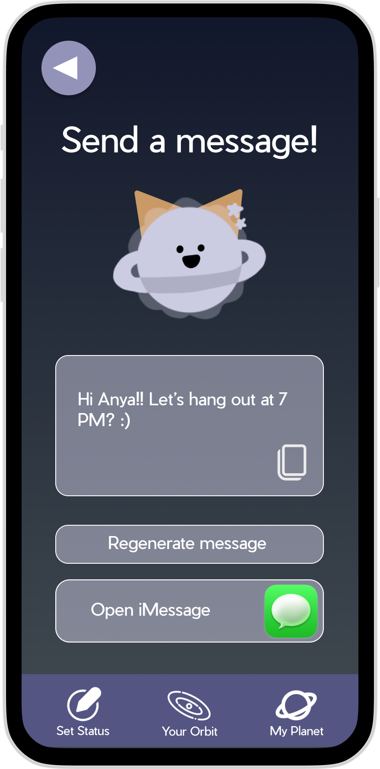
Progress towards usability goals
Intuitiveness
enlarged the calendar button and repositioned it for better visibility
ensured consistency across info, status, and calendar elements
clarified the goal of opening iMessage instead of initiating in-app texting

Slide 18
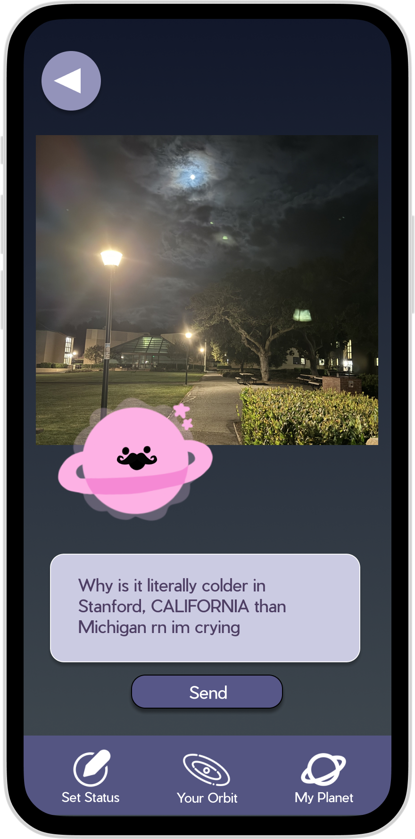
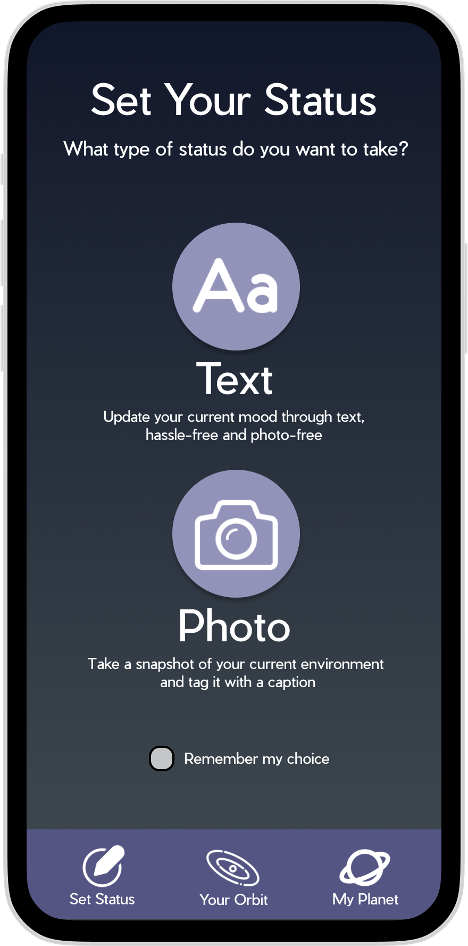
Progress towards usability goals
effectiveness
Removed “task” status (before there were task and emotion) which users found redundant
Reorganized “set status” page to emphasize text & photo

Slide 19
TaskS AND
TASK flowS

Slide 20
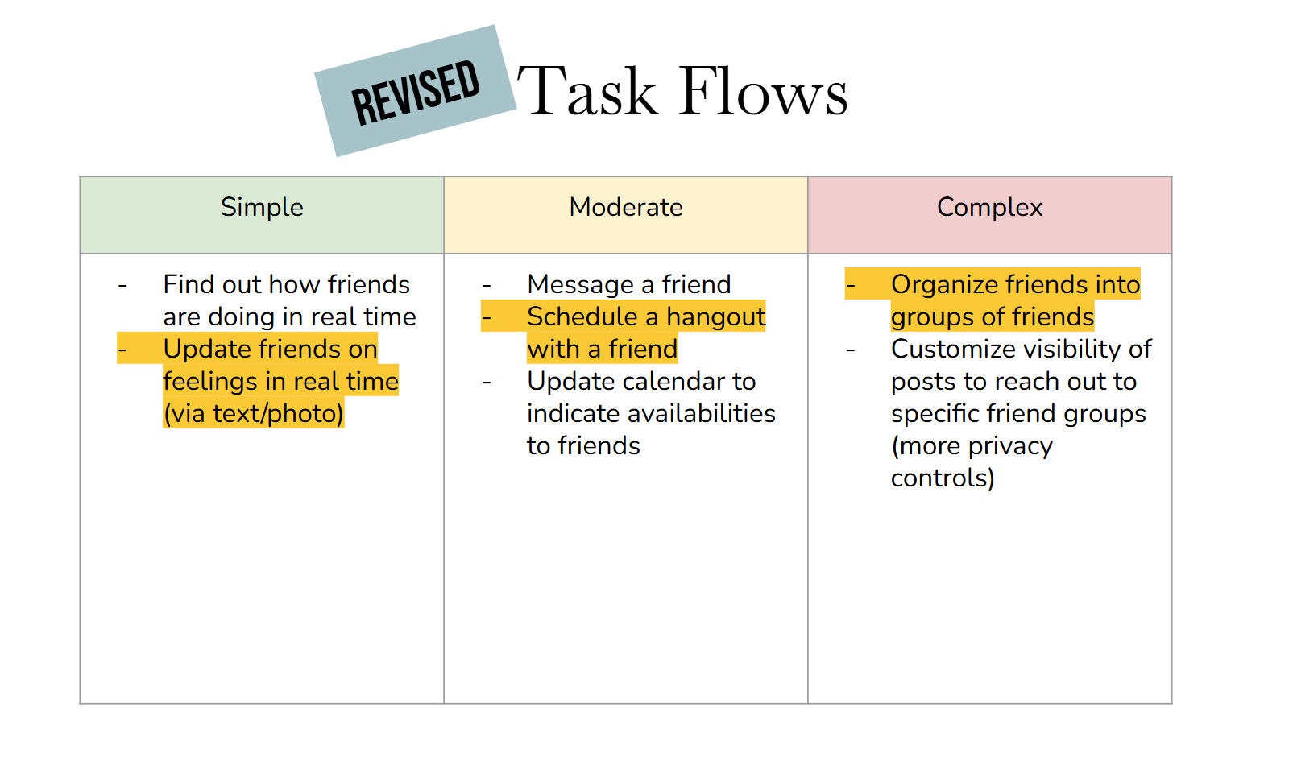

Slide 21
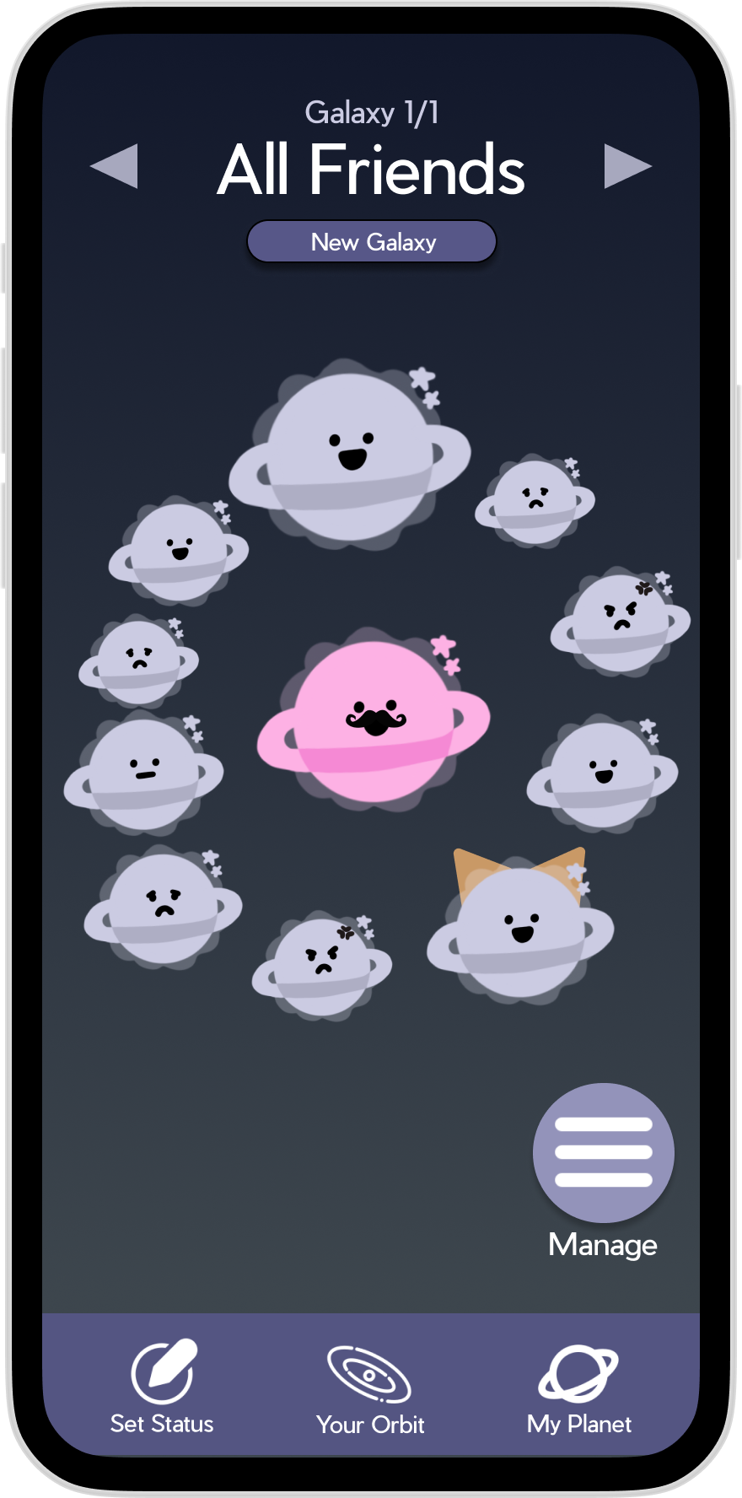
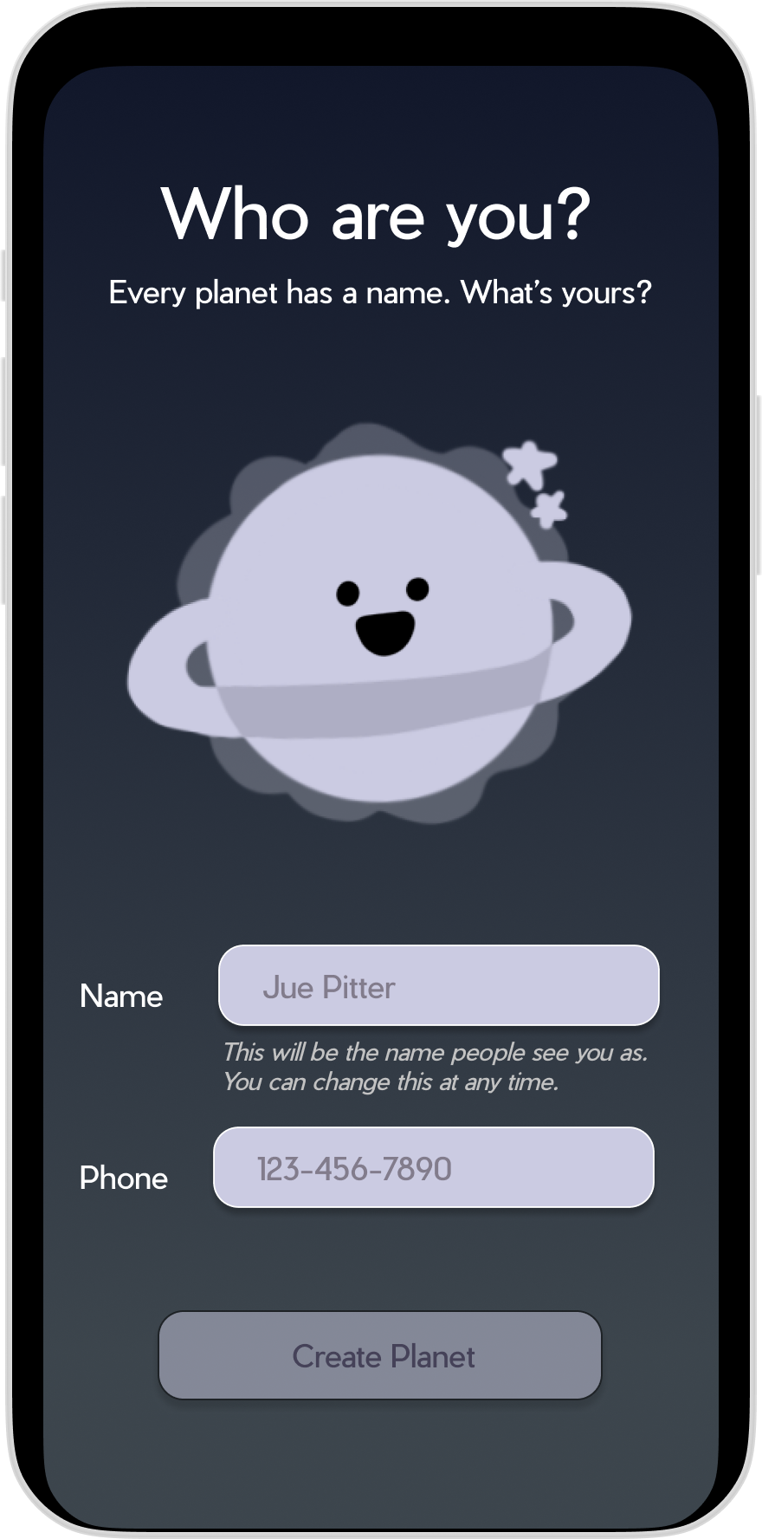
OLD Task #1: Simple
Create an account on the app

Slide 22
REVISED Task #1: Simple
Create an account on the app
Users find out how friends are doing in real time
Update friends on feelings in real time (via text/photo)

Slide 23
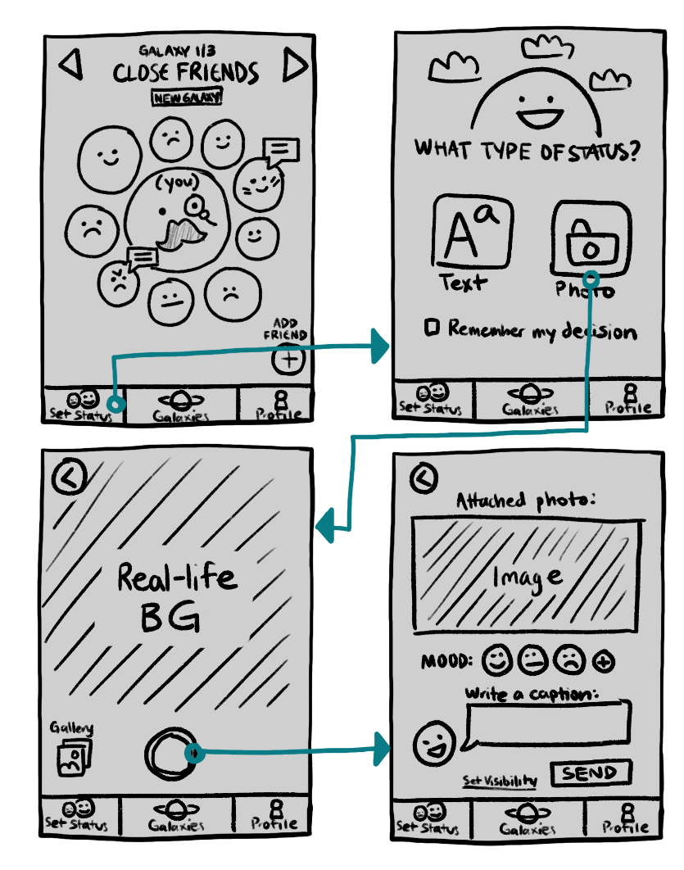
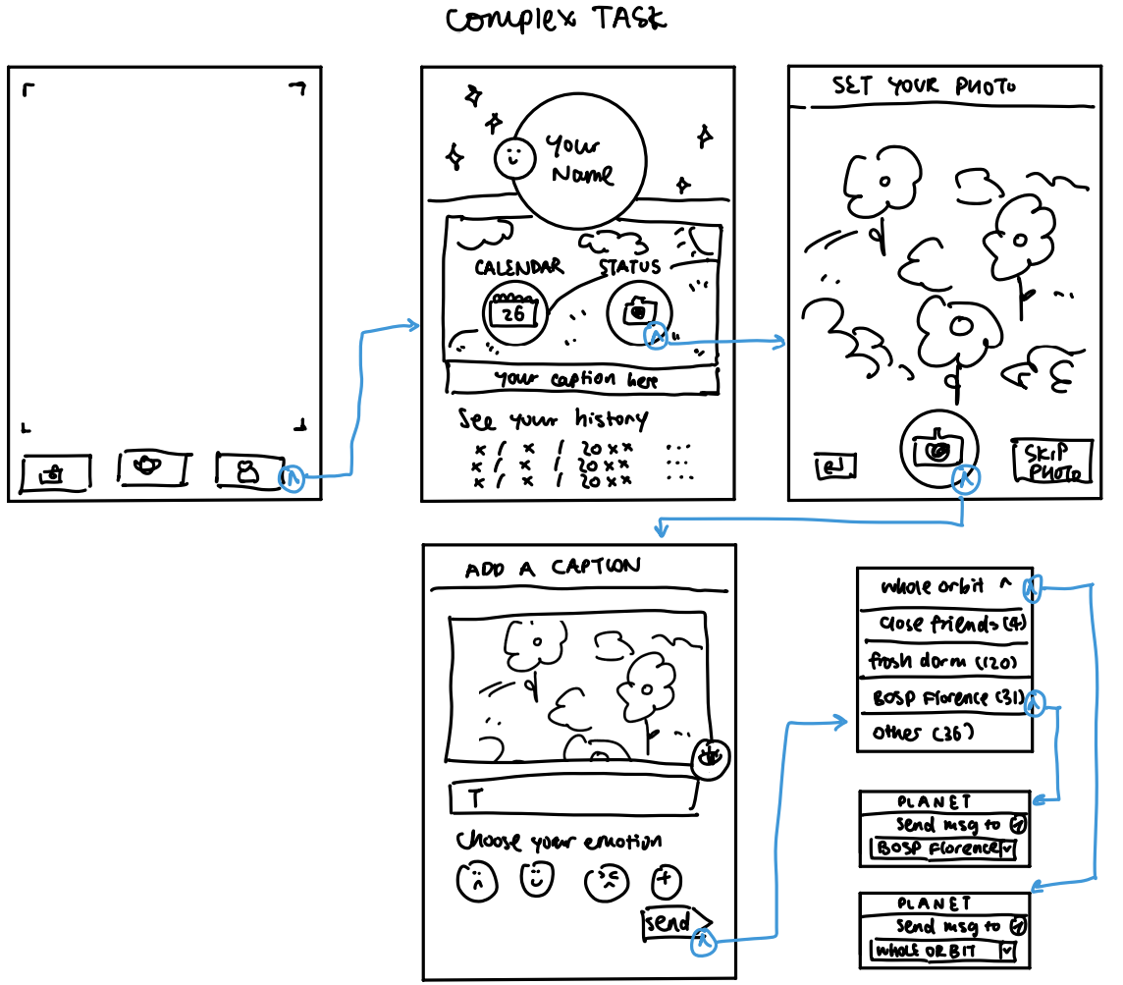
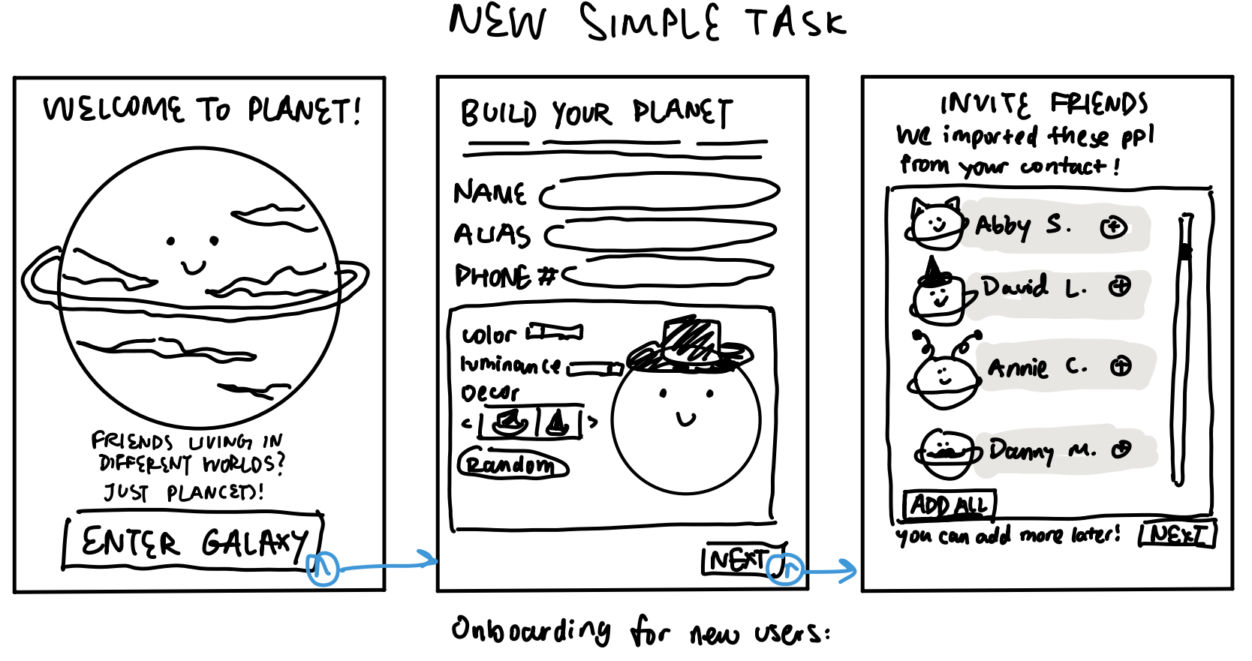
HOW TASK FLOW #1 CHANGED
(invalid simple task)
(prior sketch of
current simple task)

Slide 24
REVISED Task #1: Simple
Users find out how friends are doing in real time
Update friends on feelings in real time (via text/photo)
Changes:
Switched “set status” icon away from camera
Users can now choose between text or photo statuses
More obscure icons now have text above them
Rationale:
The app took extra steps to take text-based statuses, quick buttons improve effectiveness
Increased clarity from text improves intuitiveness

Slide 25
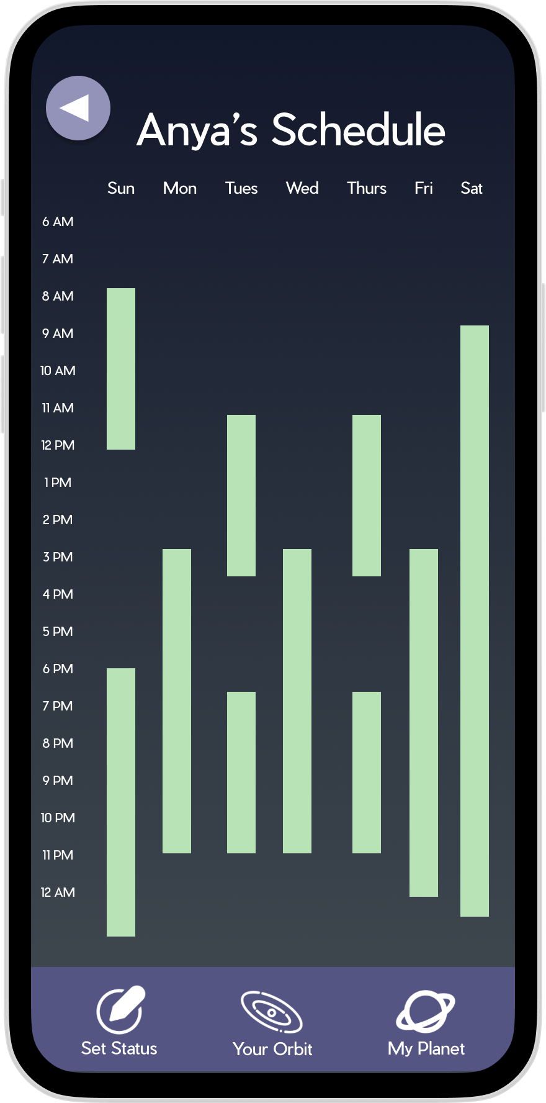
OLD Task #2: Moderate
Share photos with friends
Schedule a hangout with a friend
Update calendar to indicate availabilities

Slide 26
REVISED Task #2: Moderate
Share photos with friends
Message a friend
Schedule a hangout with a friend
Update calendar to indicate availabilities

Slide 27
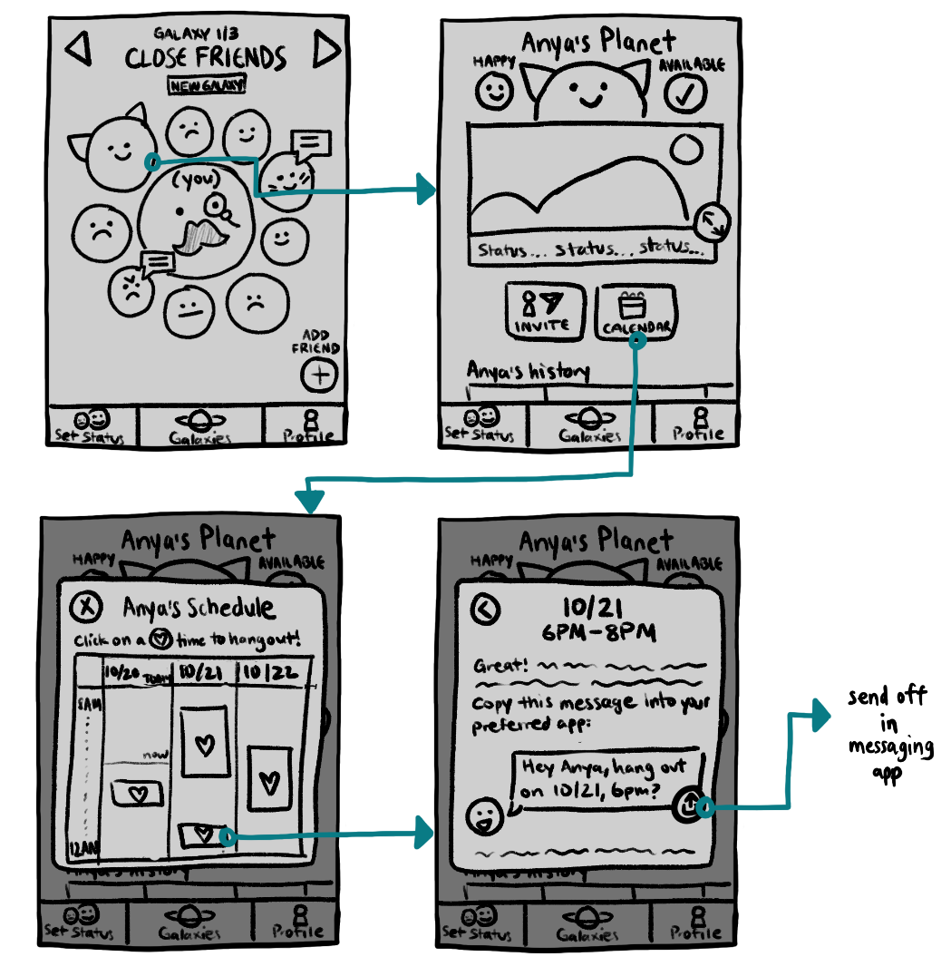
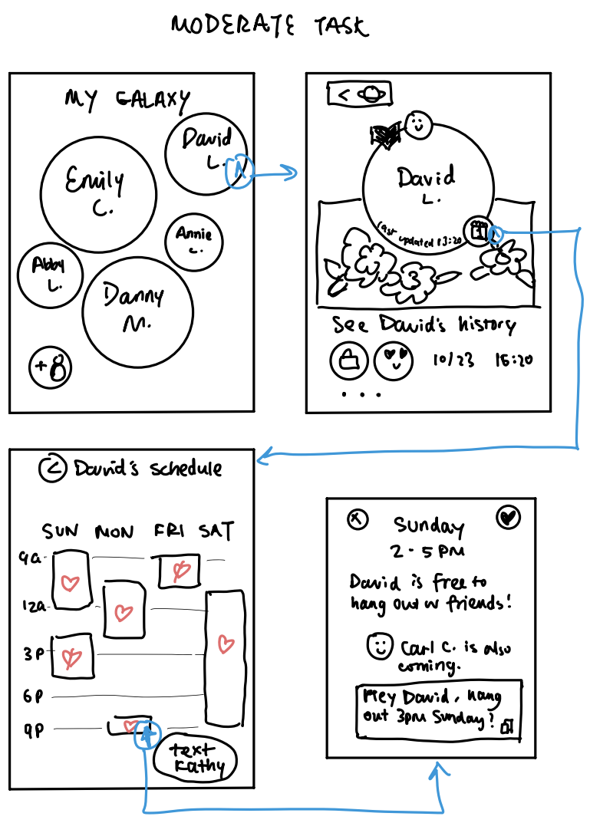
HOW TASK FLOW #2 CHANGED

Slide 28
REVISED Task #2: Moderate
Message a friend
Schedule a hangout with a friend
Update calendar to indicate availabilities
Changes:
Made calendar button larger and more evident
Added text to specify how to navigate the schedule screen
Replaced copy button with share button
Rationale:
Priority buttons are easier to navigate to, being more effective
Descriptions and recognizable icons boost intuitiveness

Slide 29
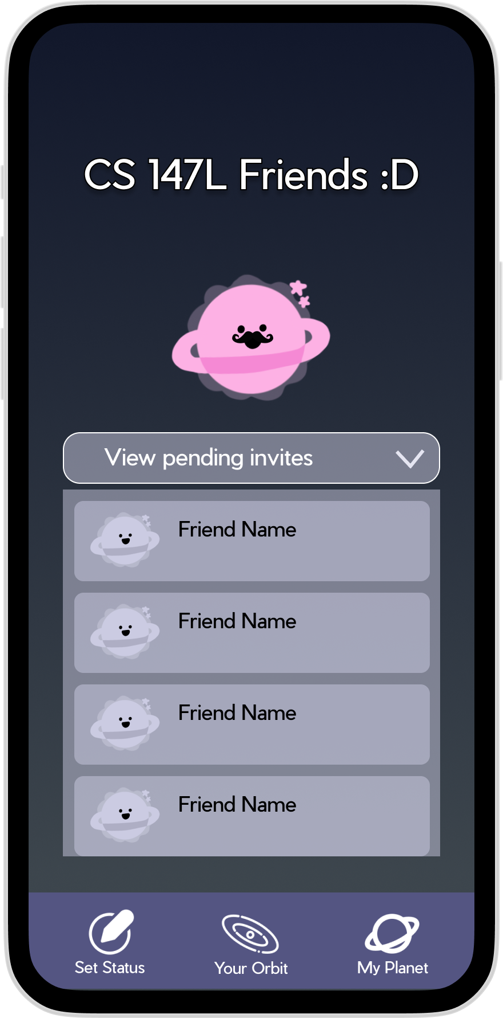
OLD Task #3: complex
Reach out to friends via a preferred texting app
Customize visibility of posts to reach out to specific friend groups

Slide 30
REVISED Task #3: complex
Reach out to friends via a preferred texting app
Organize friends into groups of people
Customize visibility of posts to reach out to specific friend groups

Slide 31
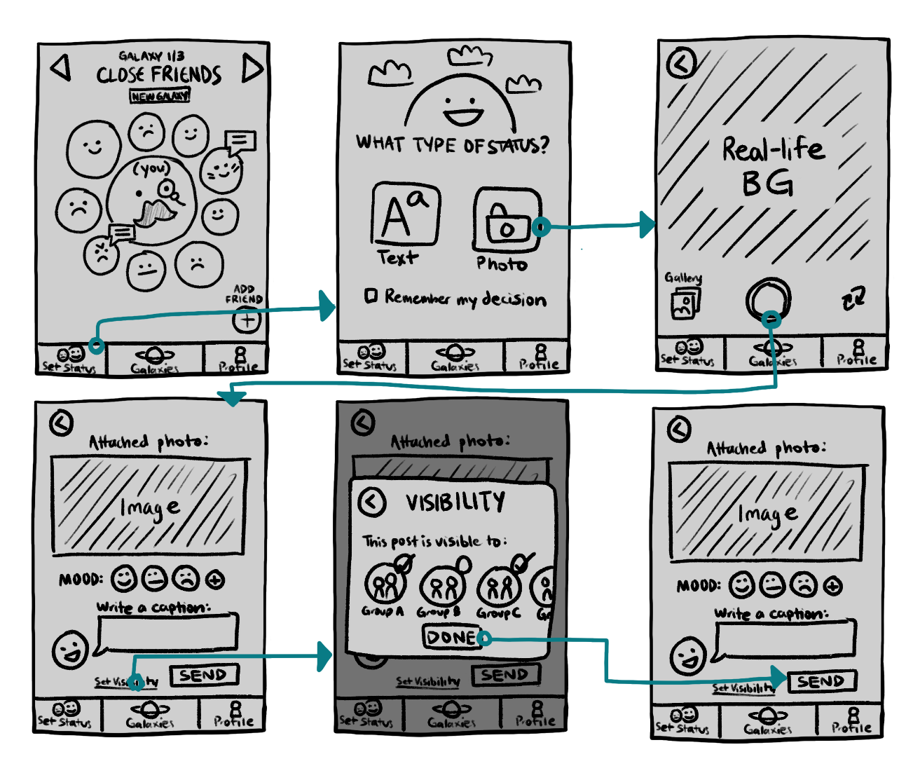
HOW TASK FLOW #3 CHANGED

Slide 32
REVISED Task #3: complex
Organize friends into groups of people
Customize visibility of posts to reach out to specific friend groups
Changes:
Added minimized “set visibility” button instead of eye icon
Used circular icons instead of dropdown menu for selecting groups
Rationale:
Complex task is made smaller, text creates a more intuitive interface
Users can now effectively choose multiple groups at once

Slide 33
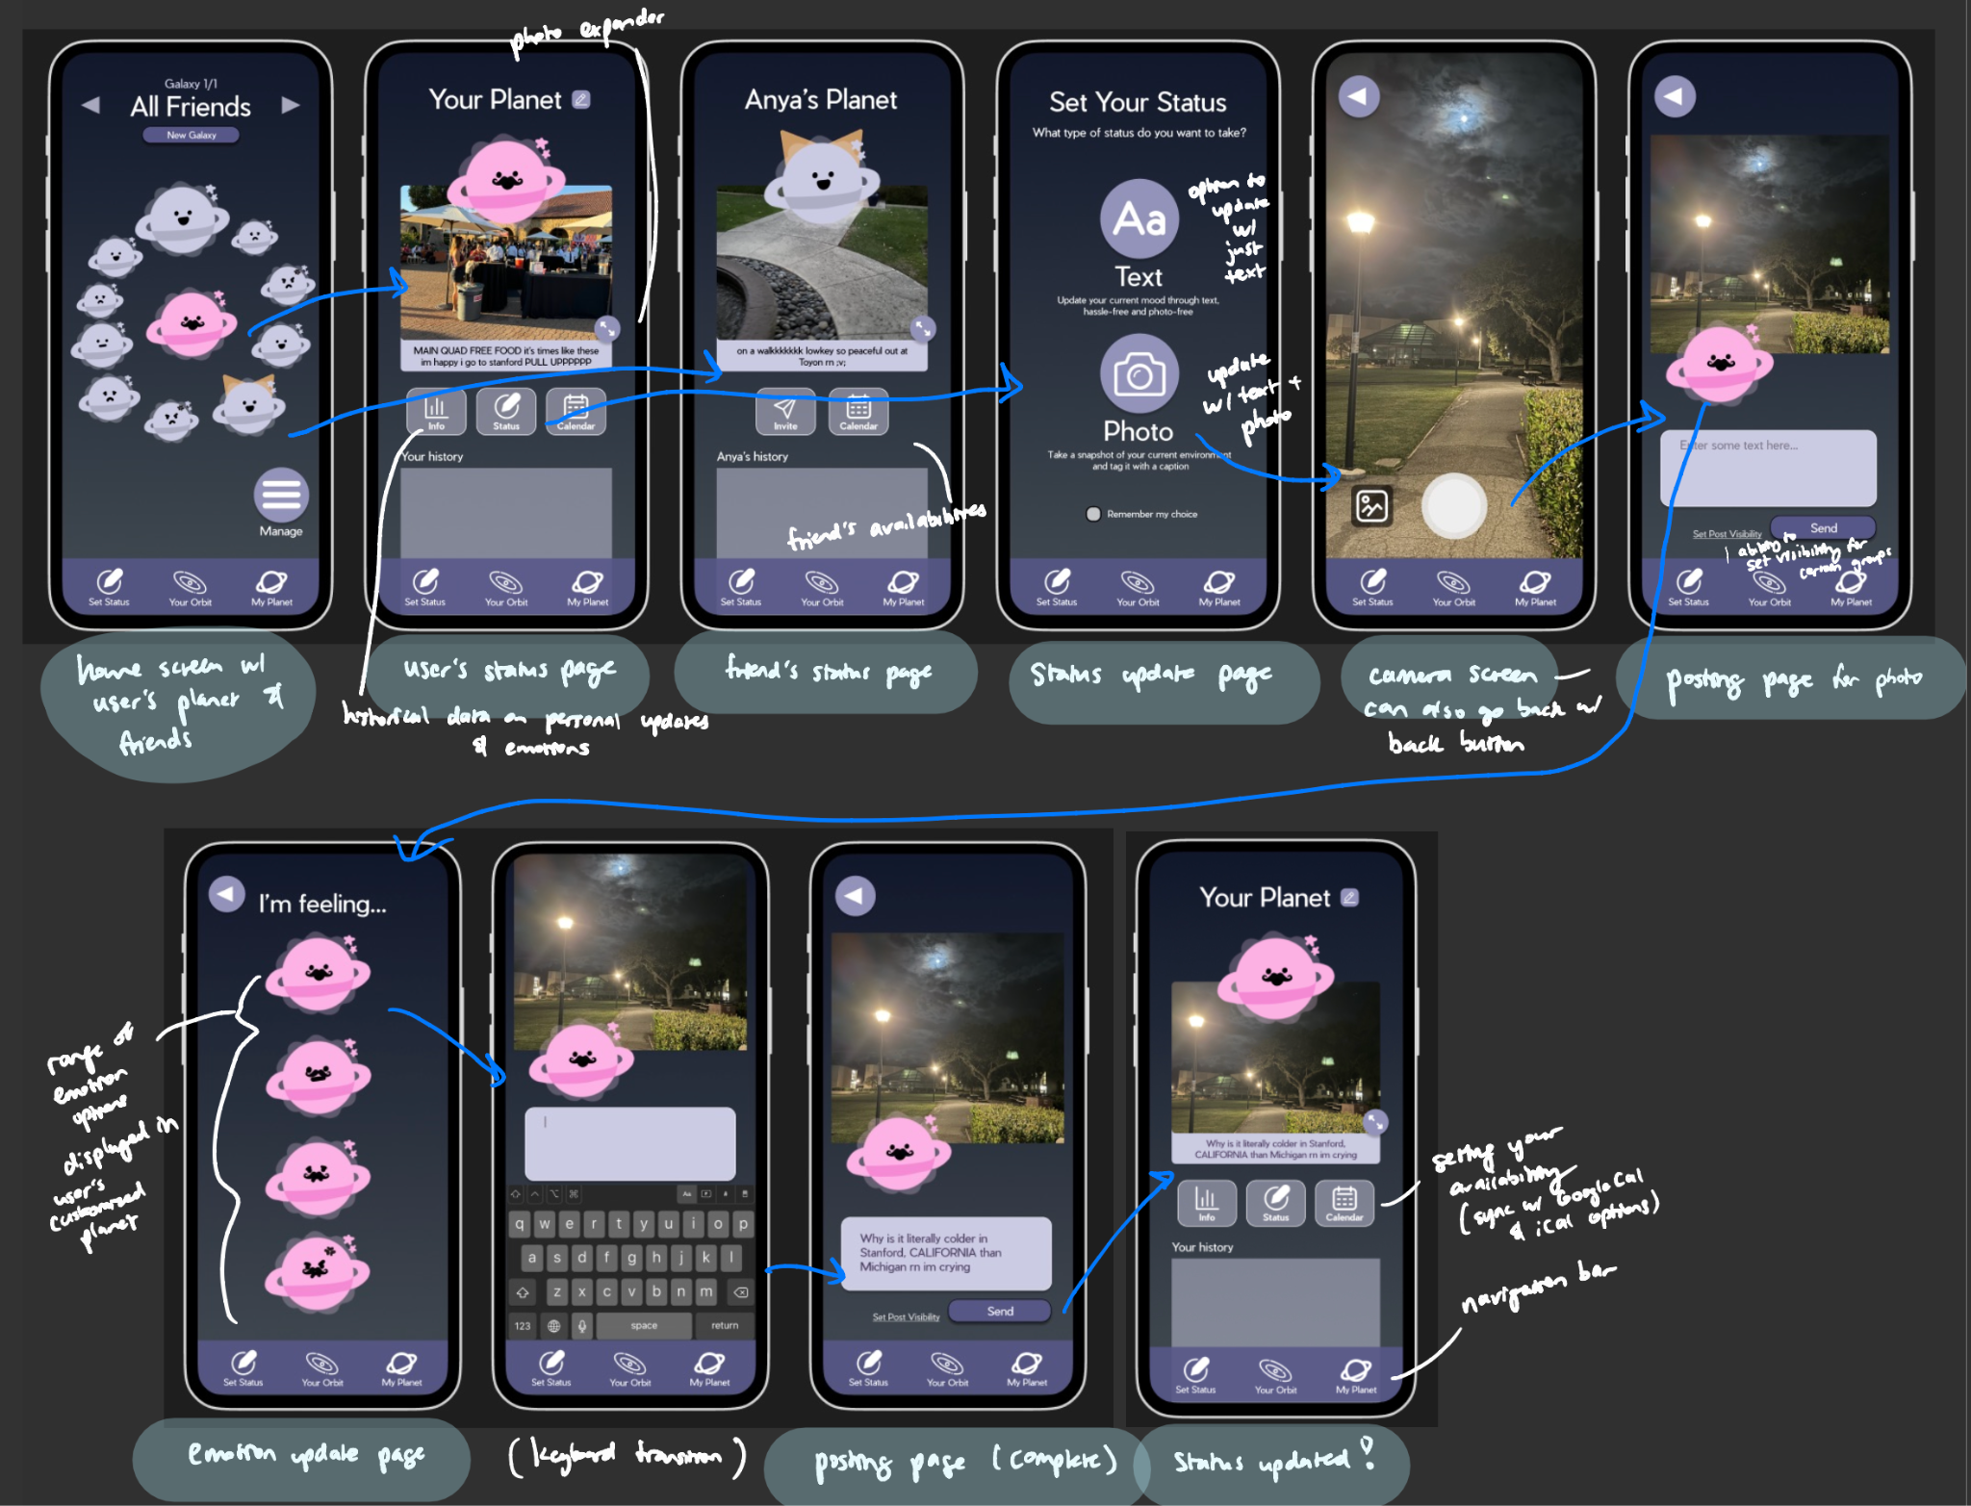
SIMPLE Task:
PHOTO STATUS UPDATE

Slide 34
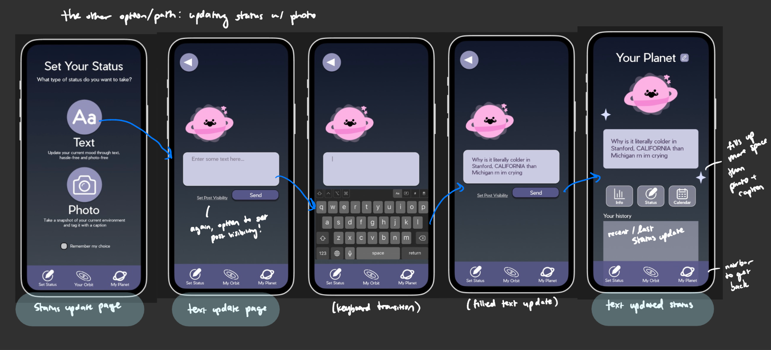
SIMPLE TASK:
TEXT STATUS UPDATE

Slide 35
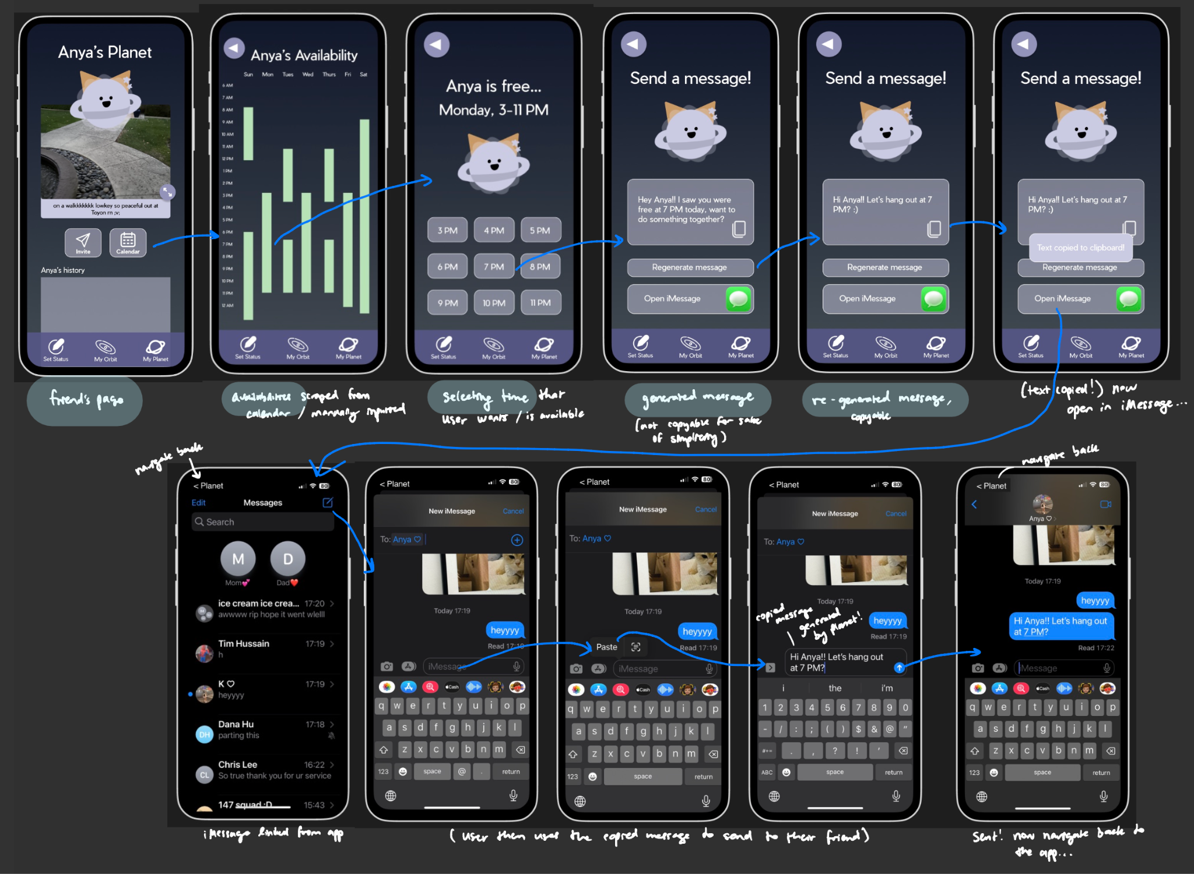
MODERATE TASK:
SCHEDULING WITH FRIEND

Slide 36
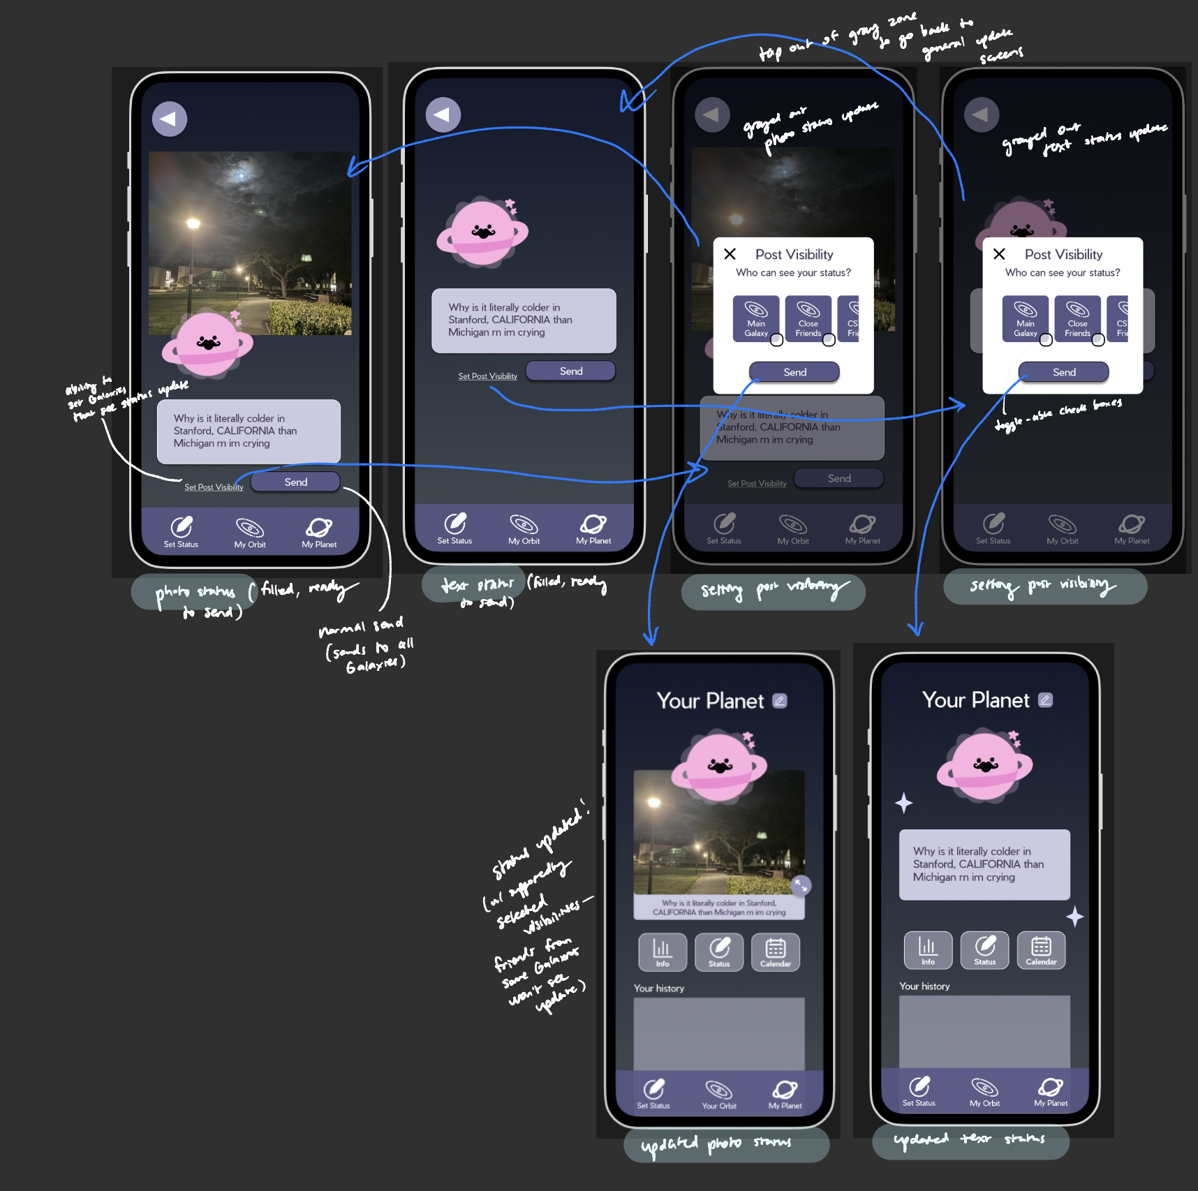
Complex task:
SET VISIBILITY

Slide 37
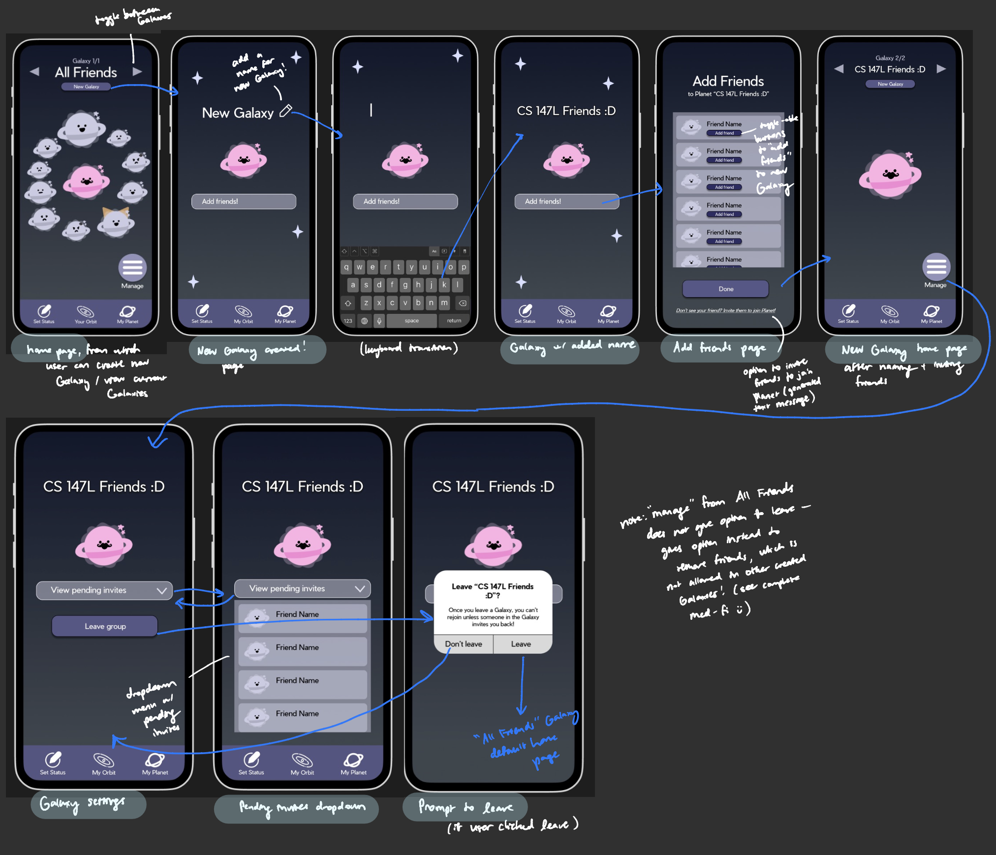
Complex task:
Organize friends into galaxies

Slide 38
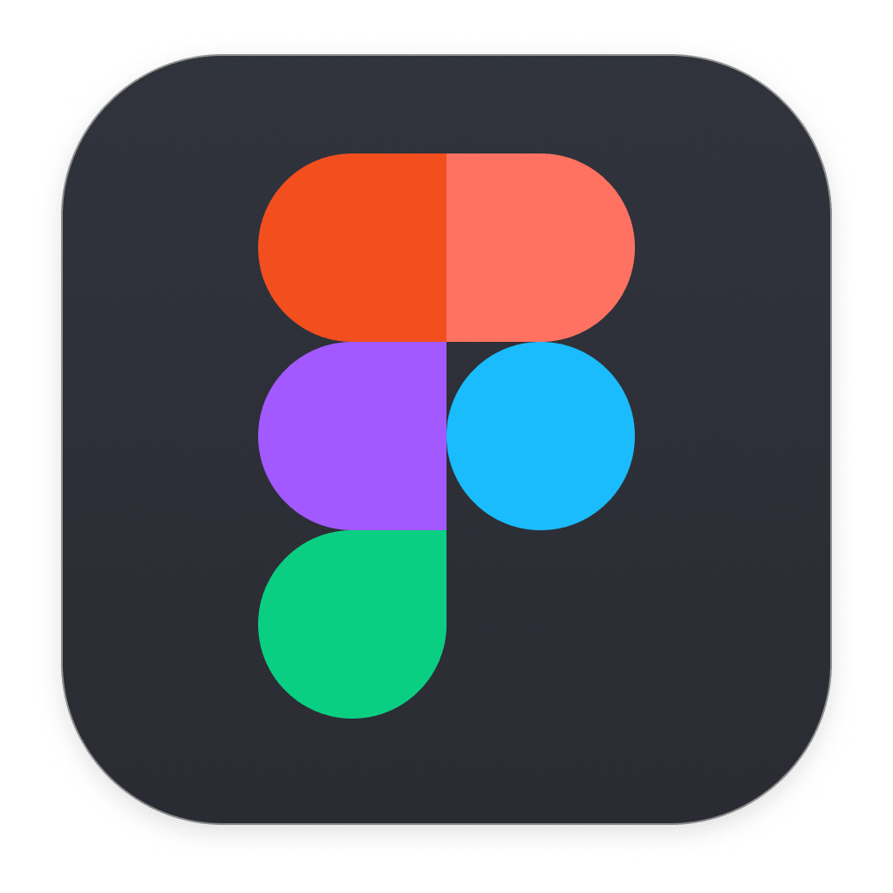
Prototype Implementation - Tools
Pros:
Easy and efficient collaboration with team members
Components make it easy to reuse pre-designed elements that fit our visual aesthetic
Prototype features allow us to accurately depict our intended tasks
Cons:
Not every member has knowledge on Figma → Figma has a steep learning curve
Limited prototyping for developers, we often had to hard-code or Wizard of Oz in features

Slide 39
Prototype Implementation - Limitations
Limited Interactivity with Characters
Currently, we have only one interactable user, Anya, for testing purposes. While this allows us to focus on refining one-on-one interactions, it limits our ability to assess how different user profiles might respond within the app.
Not able to input your own custom data or schedule information
While the main functionality of changing status and account creation is available, they aren’t able to fully input information that is personally relevant.
Prototype Constraints
Since Planet is currently a Figma prototype, not all elements are clickable or fully functional, restricting users from fully exploring more complex workflows.

Slide 40

Prototype Implementation - Wizard of Oz
Simulating iMessage
In the current prototype, we mimic the functionality of generating iMessage texts.
Simulating Data Entry
Since we don’t yet have a database, all data entries—like user preferences or statuses—are manually simulated. This includes any information that users might typically save in a profile or log.
Simulating Contacts and Friends
We automatically display contacts and friend additions in the app as if the user actually synced their contacts to the prototype.

Slide 41
APPENDIX

Slide 42
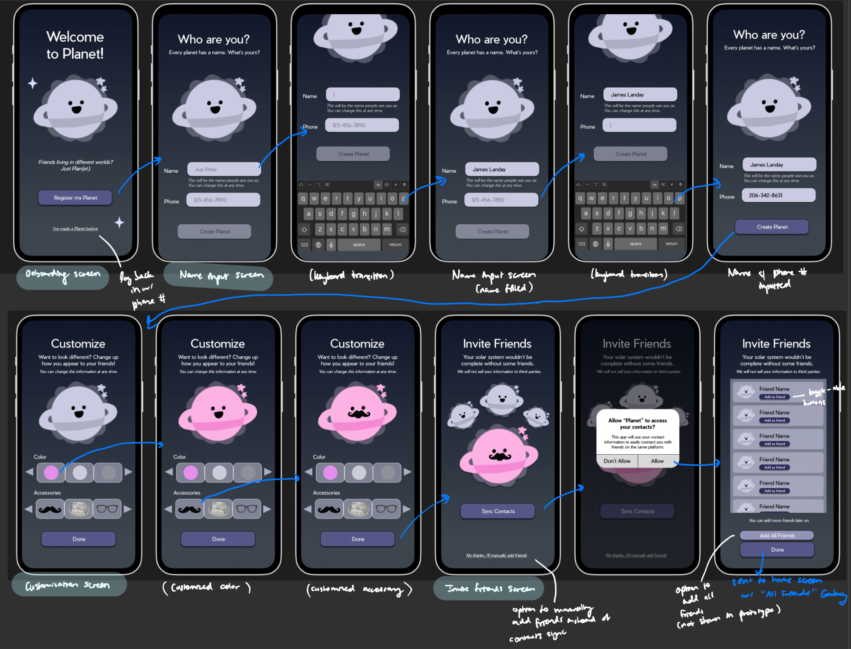
onboarding

Slide 43
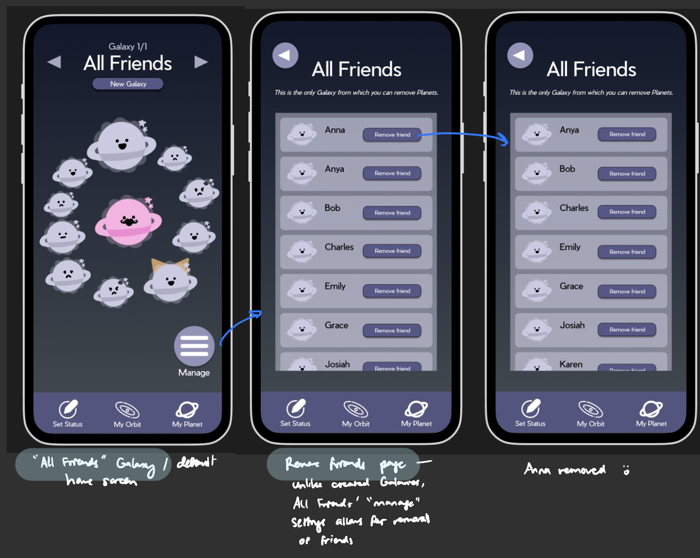
Extra:
Managing ‘all friends’

